Slide 1

“DEVELOPMENT OF A THERMAL-BASED OLFACTORY DISPLAY FOR AROMA SENSORY TRAINING”
Dayananda Sagar University
School of Engineering
Department of Electronics & Communication Engineering
Presented By
VISHAL G YADAV
[ENG16EC0095]
Guided By
Prof. KOKILA. S
Dayananda Sagar University Bengaluru-560068, India

Slide 2
CONTENTS TO BE COVERED
INTRODUCTION
MATERIALS
METHODS
EXPERIMENTS
RESULTS
CONCLUSION
REFERENCES

Slide 3
INTRODUCTION
Human olfaction (the sense of smell) if often considered the least acute of the senses in human beings. Nonetheless, we heavily rely on our sense of smell in dangerous situations, such as identifying spoiled food, toxic substances, and locating undetected fires.
Despite its importance for everyday life, olfaction has been largely neglected in educational and medical applications as we assume that it has nothing to do with our diurnal activities and schedules, Ignoring the known reality will lead to an unknown consequences.
To address the underutilization of smells, in recent years there have been significant advances in the development of olfactory displays. These displays are computer- controlled devices that generate one or more scents to a human user.
Olfactory training is currently used trend in the medical domain as a therapeutic method for treating olfactory dysfunctions and anosmia (complete loss of smell) [4]. However, the concept of ‘smell training’ also has potential for professionals that require olfactory expertise, such as perfumers and oenologists (wine specialist).
This thesis reports on the current work to develop an effective and portable olfactory display, with the intended application in education and medical solutions.

Slide 4
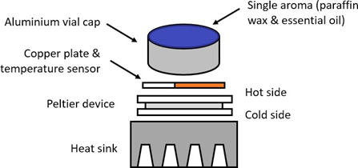
MATERIALS
Aroma Generator
The aroma generator design operates using a thermal release approach, employing Peltier heaters.
thermal techniques offer simplicity, ease of control, usually low-cost to construct and quiet operation as they have no moving parts.
This design employs (15*15*3.2)mm Peltier pads to achieve a uniform heat distribution, a sheet of copper (22*22*0.5mm) was placed on top of each ‘hot’ side of the Peltier modules.
A thin film temperature sensor (PT1000, Lab facility, UK) is embedded in the copper sheet, for temperature monitoring. The surface between the Peltier and copper was interfaced using silicone thermal grease.
Fig. 2.1. Structure of single aroma dispenser.

Slide 5
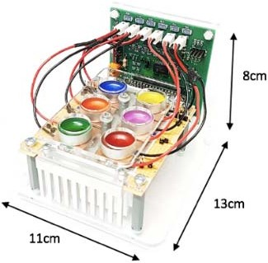
Aroma Dispenser
The aroma dispensing unit Fig. 2.2. was designed to drive up to six aroma capsules and weight 350g.
The selected enclosure was fitted with two of these units, thereby increasing the number of aroma capsules to 12, per device.
Our olfactory display is compatible with popular wine aroma essential oil training kits.
Fig. 2.2. Aroma dispensing unit.

Slide 6
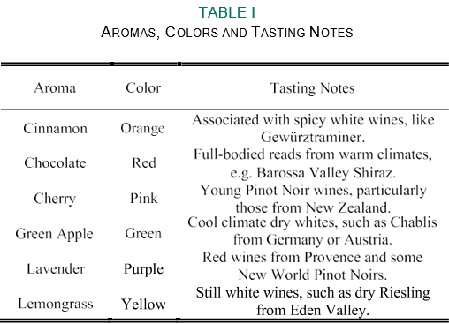
Tabular Column of Tasting Notes
METHODS
The proposed device has multiple working channels to present the user with a sequence of different aromas, or a combination of scents.
These capsules were filled with 1g of odorless paraffin wax (M220B, Specialist Crafts, UK).
Then color-coded using colored-wax (Candle Dye, LiveMoor UK) and scented using commercially available essential oils.
The oils selected for preliminary testing of the unit correspond with tasting notes from a variety of red- and white-wines, as shown in Table I.

Slide 7
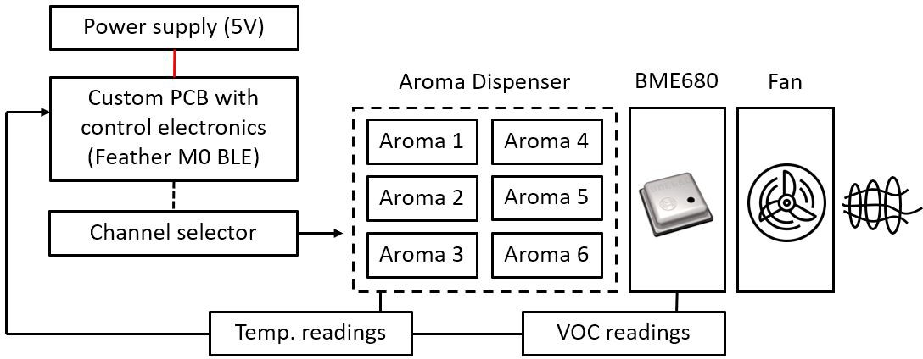
Block Diagram of the System
A custom PCB was designed for the aroma dispensing unit, which implements a simple on-off controller circuit for the Peltier pads.
Peltier devices are typically used for environmental applications where both cooling and heating is needed as they have been used previously for olfactory displays.
The unit also includes two 80mm axial fans (FMA8005AS- M, Micronel, UK), and two VOC (volatile organic compound) gas sensors (BME680, Bosch, Germany), which are mounted to the back of the fans. This allows us to monitor aroma concentration levels.
This iteration of the Feather M0 board includes a low-energy (LE) Bluetooth module (nRF51822, Nordic Semiconductor, Norway) which allows the unit to be controlled using either wired USB or Bluetooth communication.
Fig. 2.3. System block diagram.

Slide 8
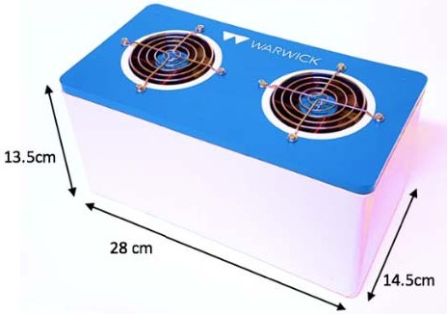
Complete Aroma Generator System
The unit can be controlled from a laptop or tablet PC and weighs 1.7kg, with two aroma dispensing units. Fig. 2.4. shows the final aroma generator.
The intended application of this device is an aroma training game, which has three elements; one training game and two sensory games.
Training Game – the user is presented with an aroma selected from the graphical user interface (GUI).
Sensory Game 1: Aroma Identification – the user is presented with an unknown aroma and the task is to match the aroma with possible options from the GUI.
Sensory Game 2: Aroma Discrimination – the user is presented with three aromas, one after the other, and the task is to identify the sample that has a different smell,
e.g. cinnamon, chocolate, Lemongrass.
Fig. 2.4. Completed aroma generator.

Slide 9
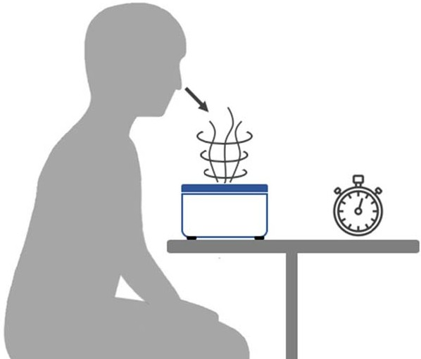
EXPERIMENTS
Two sets of experiments were conducted to evaluate the developed olfactory display.
The first experiments tested the basic functionality of the device to replicate the events in the proposed sensory games.
The second set of trials were conducted with volunteer participants, to investigate intensity levels and detection/recognition times for six different wine- related aromas.
A total of 15 healthy volunteers (were aged 20-25, with 6 females and 9 males) were recruited to participate in the olfactory display evaluation.
The experimental set-up for testing volunteers is shown in Fig. 2.5. The participants were asked to sit at a computer desk, with the olfactory display in front of them (around 30 cm away). They were then asked to lean forward, into the vertical vortex generated by the axial fan.
Subjects were told to give verbal indications when they could smell the aroma (detection) and give a running commentary of guesses regarding what the flavor of the aroma was (recognition). The six aromas, listed in Table I, were used for the volunteer experiments.
Fig. 2.5. Experimental set-up for tests with volunteers.

Slide 10
Subjects had no prior knowledge of the aroma selection. Detection and recognition times were recorded with a stopwatch.
The tests were stopped after the aroma had been correctly guessed, or if the subject was unable to identify the aroma in under 180 seconds (3 minutes).
The volunteer tests were conducted in a large room, with an extracting ceiling ventilation system. This ventilator was used to ‘reset’ the ambient environment as quickly as possible, so that the perceived smell is neutral between aromas.
Numerous studies have indicated that healthy young adults (20-39) perform best in olfactory tests. In addition to age, gender is an important factor to consider in human olfactory ability. A recent meta- review indicates that women generally outperform men in every aspect of olfactory abilities (including identification, dis- crimination and thresholds).
Along with other sensory functions, the sense of smell is known to decline with age. This condition is referred to as presbyosmia and affects over 50% of individuals between the ages of 65-80

Slide 11
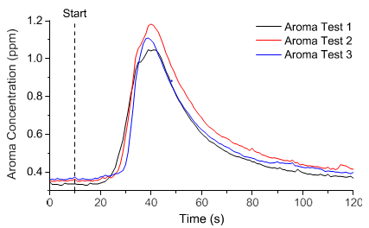
RESULTS
Functionality Testing
olfactory training usually involve participants sensing vials between 10-15 seconds. Experiments to demonstrate the basic functionality of the device therefore focused on creating consistent and reproducible aroma pulses, as quickly as possible.
A single aroma channel was activated for 30 seconds and then turned off. Readings were taken from the BME680 and the internal fan was on for the duration of the recording period (2 minutes). The experiment was then repeated 3 times.
a consistent aroma pulse of 1.0-1.2 ppm can be rapidly generated, after about 30 seconds of heating. Aided by the axial fan, the aroma is quickly dissipated, and return to baseline levels. The advantage of using wax is that the aromas are ‘trapped’ at room temperature. As a result, the aromas can be deployed in a controlled manner.
Fig. 3.1. Single aroma repeatability test.

Slide 12
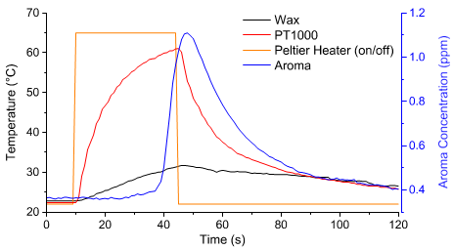
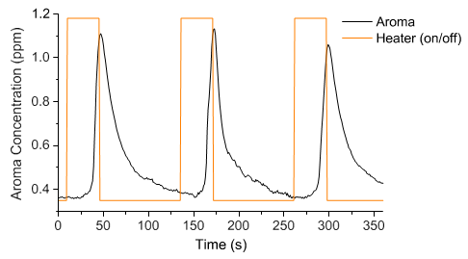
Fig. 3.2.demonstrates that the wax begins to emit significant aroma concentrations after reaching approximately 30◦C.
These heating characteristics from Fig. 3.2. can be used to produce longer aroma pulses, with constant ppm outputs.
This can be achieved by using either the readings from the BME680 gas sensor, or PT1000 temperature sensor, to create a feedback loop.
Fig. 3.2. Aroma capsule temperature.
These parameters can be used to control the duty-cycle of the Peltier heaters, to maintain a constant aroma output.
The aromas can be presented in under 40 seconds, with a 20 second period during which the aroma concentration is significantly detectable.
Moreover, the aromas are observed to quickly drop back to baseline levels, which avoids cross-contamination between scents. Baseline levels shown in Fig. 3.3. are not zero ppm, due to VOCs present in ambient air.
Fig. 3.3. Aroma discrimination.

Slide 13
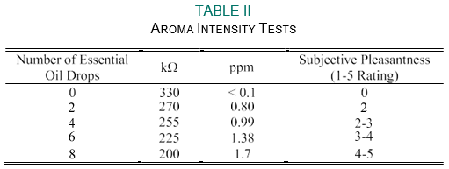
Intensity Testing
Prior to conducting tests with volunteers, it was necessary to determine what aroma intensity levels would be appropriate for experimentation. On a subjective ‘pleasantness’ scale, from 1-5, the aroma pulses should ideally be perceived as a 3 or 4, i.e. strong enough to easily detect and recognize.
A BME680 sensor was mounted on a clamp-stand, at the approximate height of the participant’s face (30 cm). Five aromas intensity levels were tested, using different numbers of drops for each level.
These values were recorded, as well as ratings from 1-5 from a subset of participants. The aroma intensity test results are shown in Table II. Each drop of essential oil is approximately 0.02g.
Based on the results from Table II, 6 drops (0.12g) of essential oil, per aroma capsule, was suitable to produce an appropriately pleasant aroma for volunteer testing.

Slide 14
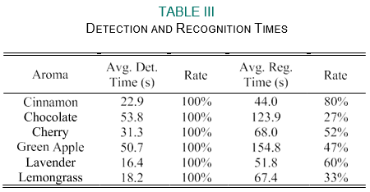
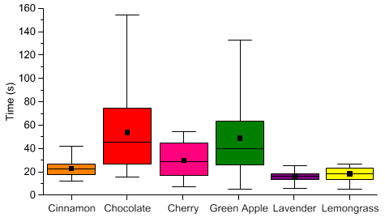
Volunteer Testing
Table III gives an overview of the volunteer test results. The ‘rate’ refers to the percentage of participants (out of 15) which were able to detect and recognize the aroma in the given time.
As shown in Table III, 100% of participants were able to detect the aromas in under 3 minutes. On average, the detection times were under 60 seconds.
Fig. 9 and 10 show box plots of the detection and recognition times, respectively.
This indicates that the intensity levels of the aromas were appropriately selected. The fastest detection times were around 10 seconds, which demonstrates that the aromas are presented to the user relatively quickly.
Cinnamon, lavender and cherry could be correctly identified by more than half of participants, with relatively short recognition times. On the other hand, chocolate could only be identified by less than a third of volunteers and green apple took more than 150 seconds (on average) to recognize.
Fig. 3.4. Detection time results.

Slide 15
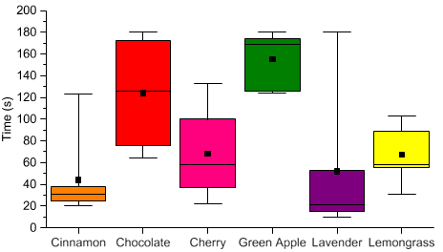
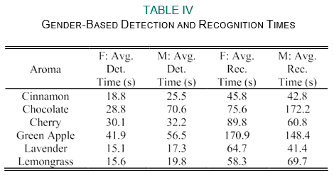
The recognition times and rates are expected to decrease with repeated testing (i.e. training). A scoring system for speed of detection and smell recognition rate could be used to measure improvement.
Fig. 3.5. Recognition time results.
Lastly, we analyzed olfactory abilities, based on gender, as shown in Table IV. It demonstrates that females consistently performed better in the detection test – outperforming males in the detection of every aroma (on average, almost 12 seconds faster).
However, the recognition time results suggest that the males were faster at recognizing the majority of aromas;
specifically: chocolate, cherry, green apple and lavender.

Slide 16
CONCLUSION
In this seminar, we have demonstrated the development of an olfactory training game, which employs a thermoelectric heating approach to present the user with wine-related aromas. The developed unit holds up to 12 different aromas that can be released individually (in the training game) or in a pre-defined sequence (sensory games 1 and 2). Testing with volunteers suggests that a run-time of at least 2 minutes is required for subjects to detect and recognize the generated smells. Differences between genders indicate that females are consistently faster at detecting aromas, while males are generally faster at recognizing them. The developed olfactory display has been successfully deployed and demonstrated.
To finally conclude, this research will help the patients with anosmia and this olfactory display will ensure them to retrieve their aroma sensing ability to correspond better to the physical world. This will also benefit scientists and researchers to understand the convolutions and to better implement a measure and demonstration of this aroma sensing feature.

Slide 17
REFERENCES
[1] D. Purves, G. Augustine, and D. Fitzpatrick, “Olfactory perception in humans,” in Neuroscience, 3rd ed. Sunderland, MA, USA: Sinauer Associates, 2001, pp. 339–341.
[2] N. S. Herrera and R. P. McMahan, “Development of a simple and low- cost olfactory display for immersive media experiences,” in Proc. 2nd Int. Workshop Immersive Media Expert., 2014, pp. 1–6.
[3] Y. Yanagida and A. Tomono, “Basics for olfactory display,” in Human Olfactory Displays and Interfaces: Odor Sensing and Presentation. Hershey, PA, USA: IGI Global, 2013, pp. 60–86.
[4] M. Damm et al., “Olfactory training is helpful in postinfectious olfac- tory loss: A randomized, controlled, multicenter study,” Laryngoscope, vol. 124, no. 4, pp. 826–831, Apr. 2014.
[5] G. Morrot, F. Brochet, and D. Dubourdieu, “The color of odors,” Brain Lang., vol. 79, no. 2, pp. 309–320, 2001.
[6] J. Robinson, The Oxford Companion to Wine, 3rd ed. New York, NY, USA: Oxford Univ. Press, 2006.
[7] L. Seal. (2018). Understanding Tasting Notes. Accessed: Nov. 3, 2018 [Online]. Available: https://www.decanter.com/learn/advice/understand- tasting-notes-decoded-344920/
[8] D. W. Kim, Y. H. Cho, K. Nishimoto, Y. Kawakami, S. Kunifuji, and H. Ando, “Development of aroma-card based soundless olfactory display,” in Proc. 16th IEEE Int. Conf. Electron. Circuits Syst. (ICECS), Dec. 2009, pp. 703–706.

Slide 18
THANKYOU FOR YOUR PATIENCE!

